Slide 1
EXPLORING SPECTRAL INDICES IN Google Earth Engine Mary Amponsah mamponsah@ug.edu.gh Center for Remote Sensing and Geographic Information Services (CERSGIS)
Accra, Ghana
September, 2021

Slide 2
OVERVIEW
Spectral Indices are combinations of spectral reflectance from two or more wavelengths that indicate the relative abundance of features of interest
There are different indices for vegetation, built-up features, water and burned areas
In this section we will have hands-on tutorial exploring some vegetation indices

Slide 3
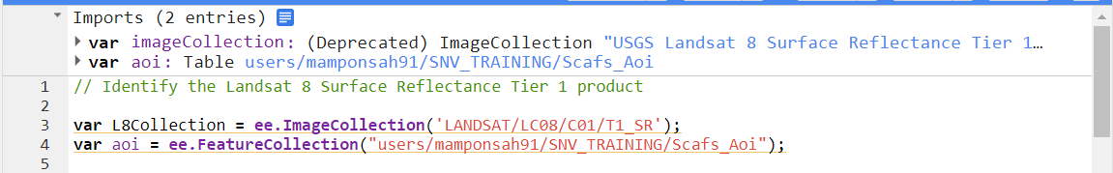
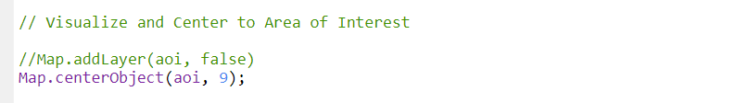
Importing Image and Feature Collections
Import the Landsat 8 Surface Reflectance collection as well as the Study Area
Visualize area of interest and centre visualization to your area of interest
Notes:
Landsat scenes with the highest available data quality are placed into Tier 1. They are precise, terrain and radiometry corrected, and inter-calibrated across the different Landsat Instruments.

Slide 4
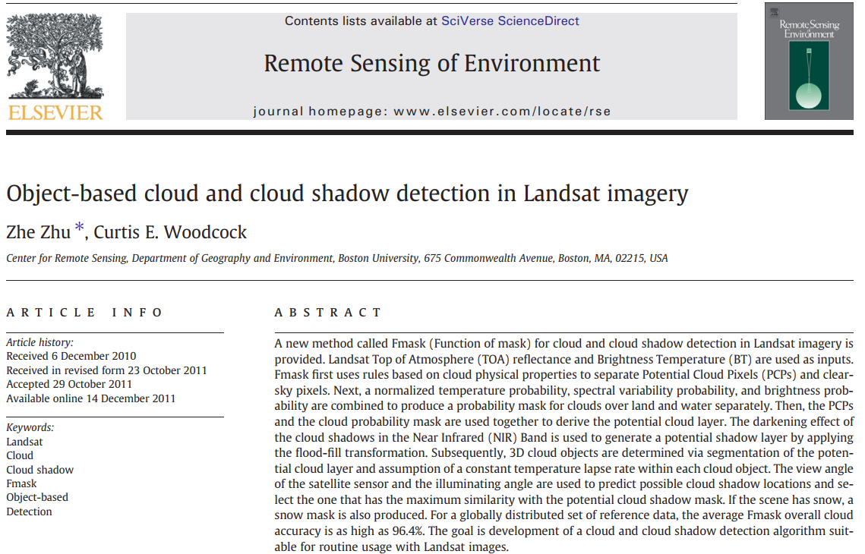
Cloud Masking
Cloud information stored in the pixel_qa band
Cloud flags are based on the CFMASK algorithm
Clouds and cloud shadows are screened out at all confidence levels
Zhu, Z., & Woodcock, C. E. (2012). Object-based cloud and cloud shadow detection in Landsat imagery Remote sensing of environment, 118, 83-94.

Slide 5
Cloud Masking
FMASK implements a rule‐based algorithm
Initial spectral test to identify cloud pixels
Determine cloud probability based on brightness and temperature
Identify potential cloud shadows using a flood‐fill test based on the NIR band
Estimate cloud height (based on temperature) and identify the shadow associated with each cloud object

Slide 6
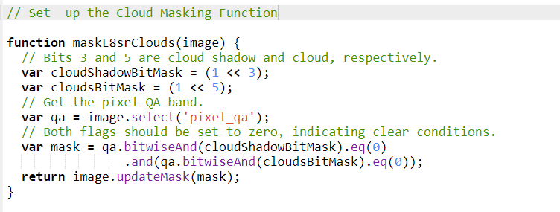
Cloud Masking
Set up the Cloud Masking Function

Slide 7
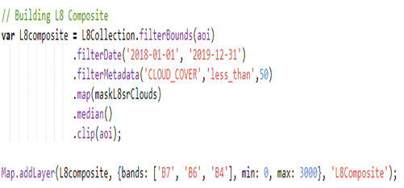
Filtering an ImageCollection
Build image composite with;
filterBounds()
filterDate()
filterMetadata(cloud cover)
Map to the cloud mask
Reducer, median()
Clip to area of interest
Visualization of the image composite in false colour.

Slide 8
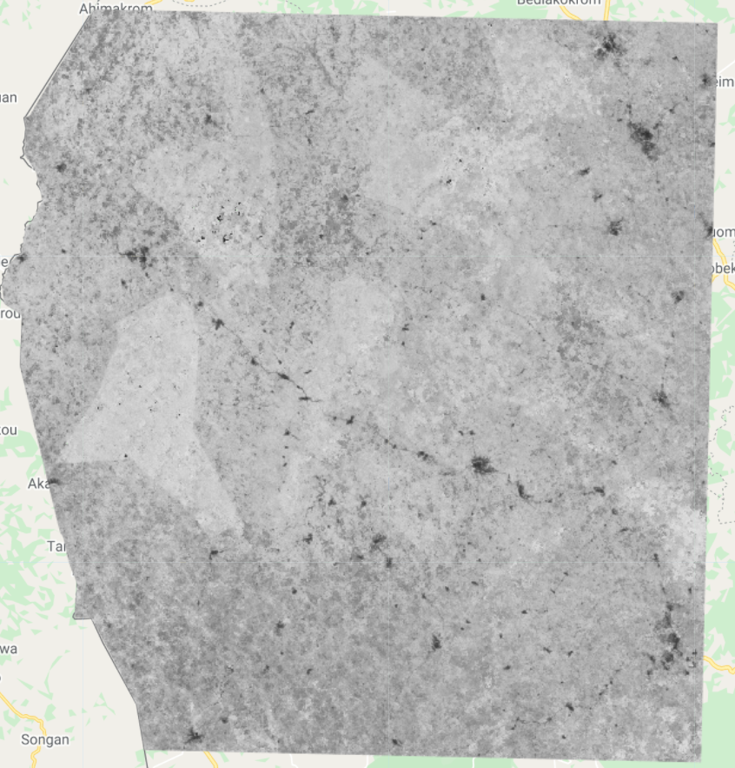
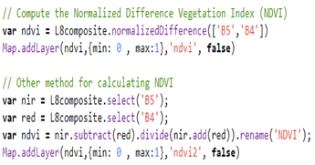
Calculating NDVI
Calculate the NDVI using the normalizedDifference() method.
The normalized difference is computed as (NIR – Red) / (NIR + Red)
NIR is band 5, and red is band 4.
NDVI output of Study Area

Slide 9
Tasselled Cap Transformation
Tasseled Cap Transformation is a method to transform spectral information of satellite data into spectral indicators, useful for vegetation analysis
Provides an analytical way to detect and compare changes in vegetation, soil, and man-made features over time
Coefficients used in the linear equation of Tasseled Cap transformation are sensor specific
The first three bands created are generally held to represent
Brightness: measured value for the ground
Greenness: measured value for vegetation
Wetness: measured value for canopy moisture

Slide 10
Tasselled Cap Transformation
Derivation of the three levels of information for Landsat is a weighted sum of the bands (without the thermal channel 6), where each band is multiplied by its specific coefficient:
Brightness = 0.3037 (band 1) + 0.2793 (band 2) + 0.4743 (band 3) + 0.5585 (band 4) + 0.5082 (band 5) + 0.1863 (band 7)
Greenness = −0.2848 (band 1) − 0.2435 (band 2) − 0.5436 (band 3) + 0.7243 (band 4) + 0.0840 (band 5) − 0.1800 (band 7)
Wetness = 0.1509 (band 1) + 0.1973 (band 2) + 0.3279 (band 3) + 0.3406 (band 4) − 0.7112 (band 5) − 0.4572 (band 7)
References:
Benefoh, D. T., et al (2018). Assessing land-use typologies and change intensities in a structurally complex Ghanaian cocoa landscape. Applied Geography, 99, 109-119
Crist, E. P., & Kauth, R. J. (1986). The Tasseled Cap de-mystified.[transformations of MSS and TM data

Slide 11
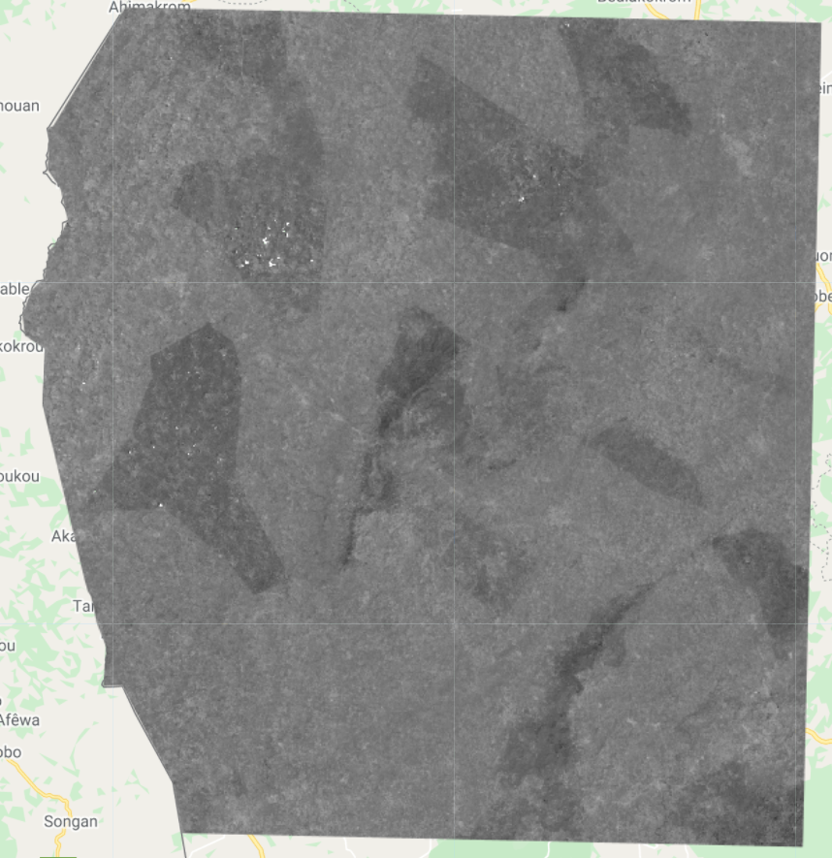
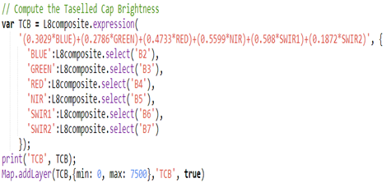
Tasselled Cap Brightness (TC-B)
Generating the three tasseled cap bands the same way as done in Benefoh et al., 2018 using the bands; Blue, Green, Red, Near Infrared and the Shortwave Infrared bands of Landsat
Tasseled Cap Brightness output of study area

Slide 12
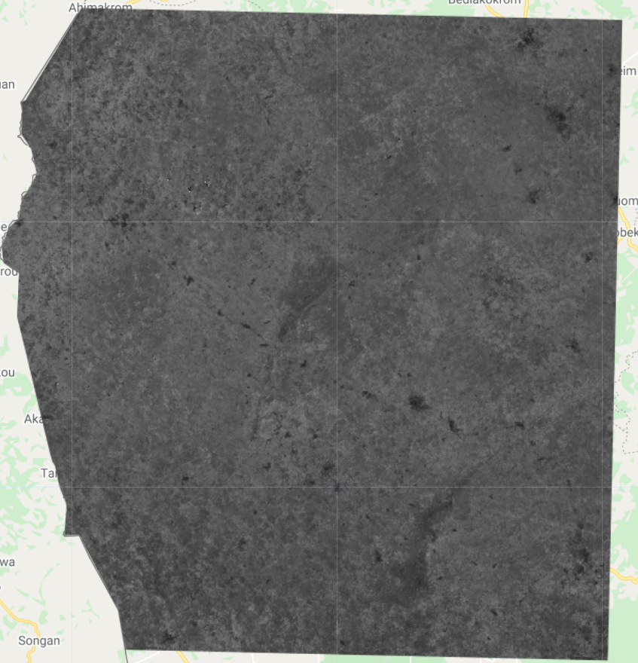
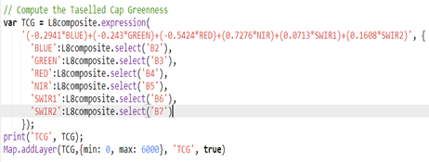
Tasselled Cap Greenness (TC-G)
Compute for tasseled cap greenness in GEE
Tasseled Cap Greenness output of Study Area

Slide 13
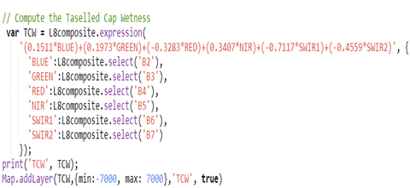
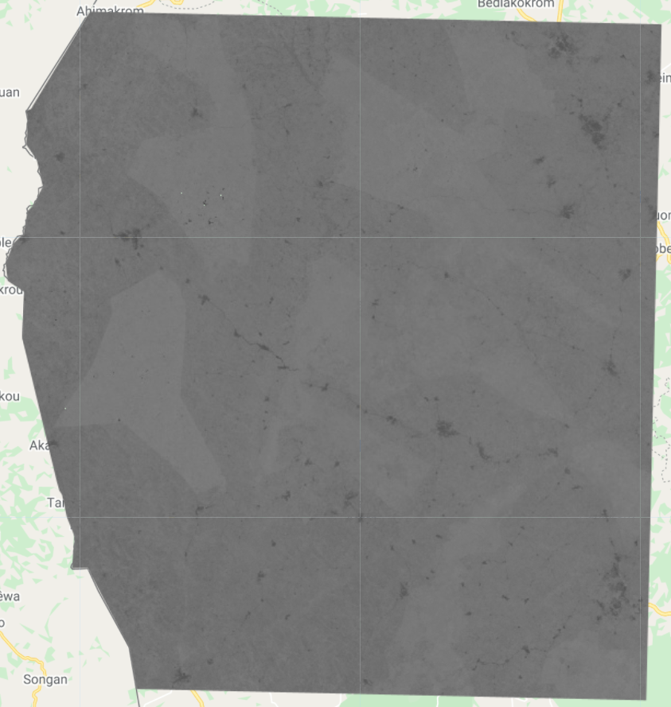
Tasselled Cap Wetness (TC-W)
Compute for tasseled cap wetness using derived coefficients for Landsat data
Tasseled Cap Wetness output of study area

Slide 14
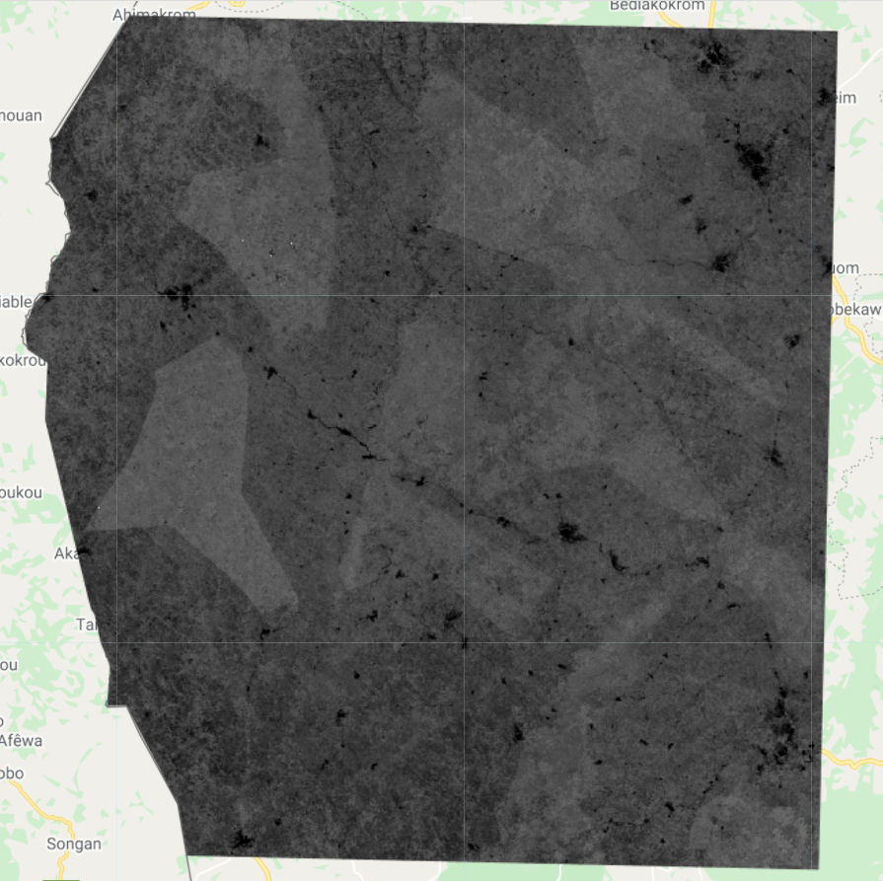
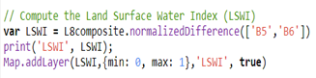
Land Surface Water Index (LSWI)
Calculate the LSWI using the normalizedDifference() method.
The normalized difference is computed as (NIR – SWIR1) / (NIR + SWIR1)
NIR is band 5
Shortwave infrared 1 is band 6.
LSWI output of study area

Slide 15
Link to GEE script
https://code.earthengine.google.com/6ad36941f20205fbac622bba36cbda42

Slide 16
Hands-on Exercises
Using Sentinel-2 MSI: Multispectral Instrument, Level-1C Image Collection, compute the following indices to the training area of interest in Google Earth Engine:
Normalized Difference Water Index (NDWI)
Normalized Burned Ratio Index (NBRI)
Normalized Difference Built-up Index (NBRI)
Enhanced Vegetation Index (EVI)

Slide 17




Thank You
Accra, Ghana
September, 2021
Notes:
It's free for non-commercial use!

